Slide 1
Implementation of Linear Probing (continued)
Helping method for locating index:
private int findIndex(long key)
// return -1 if the item with key 'key' was not found
{
int index = h(key);
int probe = index;
int k = 1; // probe number
do {
if (table[probe]==null) {
// probe sequence has ended
break;
}
if (table[probe].getKey()==key)
return probe;
probe = (index + step(k)) % table.length; // check next slot
k++;
} while (probe!=index);
return -1; // not found
}

Slide 2
Implementation of Linear Probing (continued)
Find and Deleting the item:
public T find(long key)
{
int index = findIndex(key);
if (index>=0)
return (T) table[index];
else
return null; // not found
}
public T delete(long key)
{
int index = findIndex(key);
if (index>=0) {
T item = (T) table[index];
table[index] = AVAILABLE; // mark available
return item;
} else
return null; // not found
}

Slide 3
Open addressing:
Quadratic Probing
Designed to prevent primary clustering.
It does this by increasing the step by increasingly large amounts as more probes are required to insert a record. This prevents clusters from building up.
  In quadratic probing the step is equal to the square of the probe number.
  With linear probing the step values for a sequence of probes would be {1, 2, 3, 4, etc}. For quadratic probing the step values would be {1, 2², 3², 4², etc}, i.e. {1, 4, 9, 16, etc}.
Disadvantage of this method:
  After a number of probes the sequence of steps repeats itself (remember that the step will be probe number² mod the size of the hash table). This repetition occurs when the probe number is roughly half the size of the hash table.
  Secondary clustering.

Slide 4
Open addressing:
Quadratic Probing
Disadvantage of this method:
  After a number of probes the sequence of steps repeats itself. => It fails to insert a new item even if there is still a space in the array.
  Secondary clustering: the sequence of probe steps is the same for any insertion. Secondary clustering refers to the increase in the probe length (that is the number of probes required to find a record) for records where collisions have occurred (the keys are mapped to the same value). Note that this is not as large a problem as primary clustering.
However, it is important to realize that in practice these two issues are not significant, given a large hash table and a good hash function it is extremely unlikely that these issues will affect the performance of the hash table, unless it becomes nearly full.
Notes:
Emphasize difference between primary and secondary clustering.

Slide 5
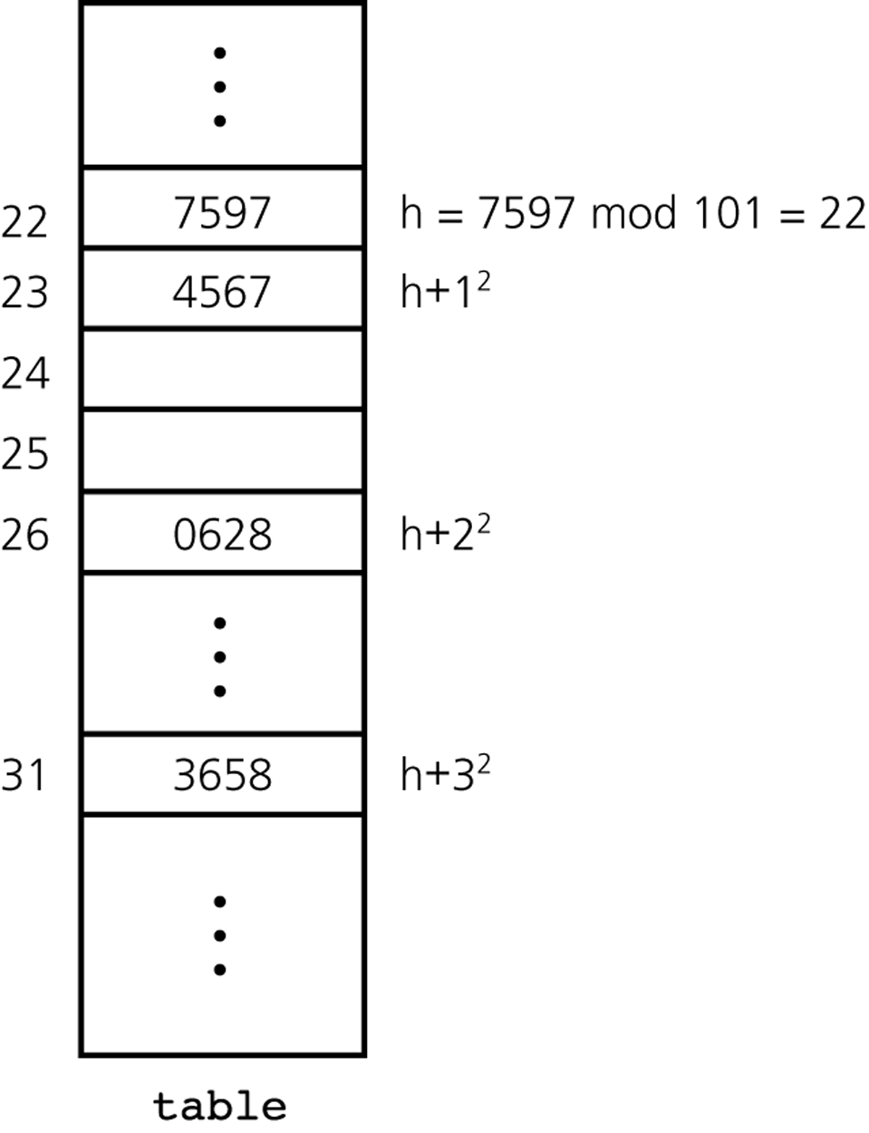
Figure: Quadratic probing with h(x) = x mod 101
Notes:
Example with array size 23.

Slide 6
Implementation
It’s enough to modify the step helping method:
private int step(int k) // step function
{
return k*k // quadratic probing
}

Slide 7
Open addressing:
Double Hashing
Double hashing aims to avoid both primary and secondary clustering and is guaranteed to find a free element in a hash table as long as the table is not full. It achieves these goals by calculating the step value using a second hash function h’.
step(k) = k.h’(key)
This new hash function h’ should:
  be different from the original hash function (remember that it was the original hash function that resulted in the collision in the first place) and,
  not result in zero (as original index + 0 = original index)
Notes:
Show examples, why are these two conditions necessary.

Slide 8
Open addressing:
Double Hashing
The second hash function is usually chosen as follows:
h’(key) = q – (key%q),
where q is a prime number q<N (N is the size of the array).
Remark: It is important that the size of the hash table is a prime number if double hashing is to be used. This guarantees that successive probes will (eventually) try every index in the hash table before an index is repeated (which would indicate that the hash table is full).
  For other hashings (and for q) we want to use prime numbers to eliminate existing patterns in the data.
Notes:
Example: assume that N=10 and h’(key)=2.

Slide 9
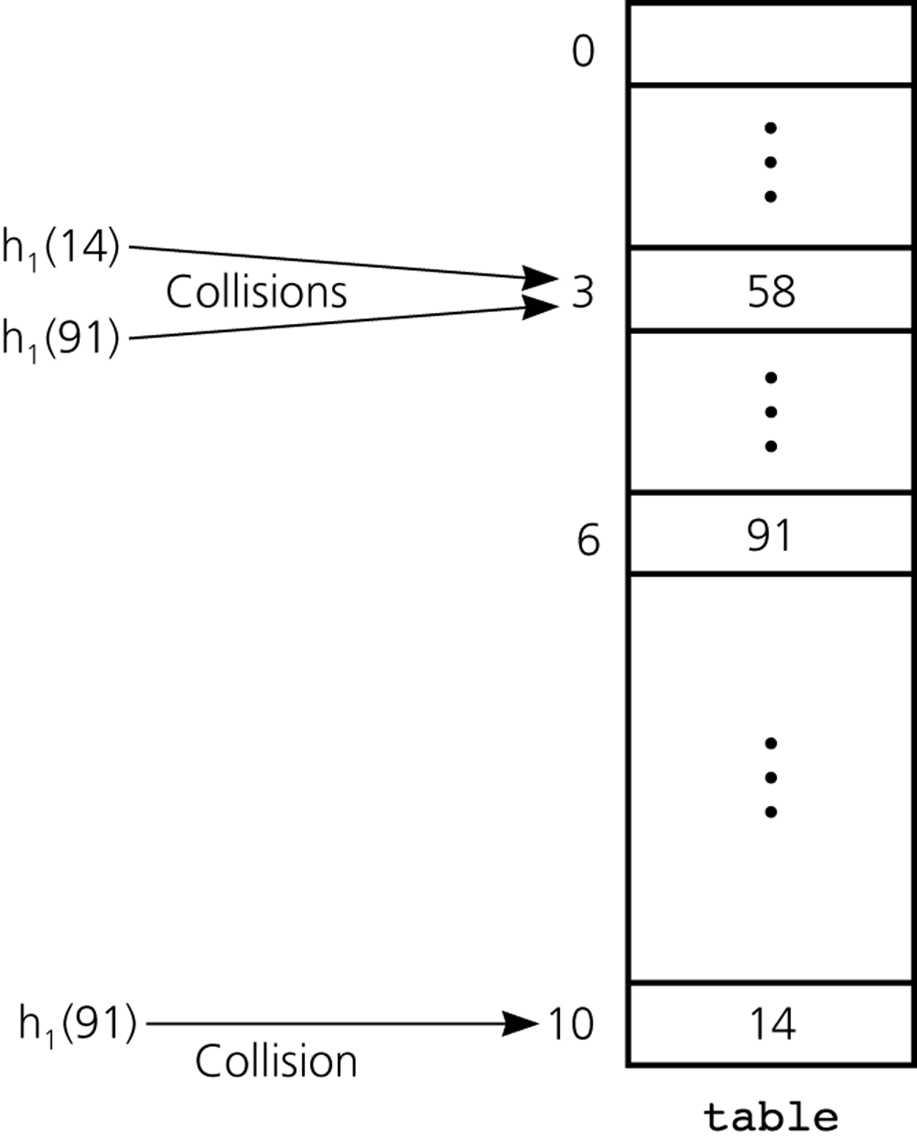
Figure: Double hashing during the insertion of 58, 14, and 91
Notes:
Example with array of size 23.

Slide 10
Double Hashing – Implementation
public class DoubleHashTable<T extends KeyedItem>
implements HashTableInterface<T>
{
private KeyedItem[] table;
// special values: null = EMPTY, T with key=0 = AVAILABLE
private static KeyedItem AVAILABLE = new KeyedItem(0);
private int q; // should be a prime number
public DoubleHashTable(int size,int q)
// size: should be a prime number;
// recommended roughly twice bigger
// than the expected number of elements
// q: recommended to be a prime number, should be smaller than size
{
table = new KeyedItem[size];
this.q=q;
}
Notes:
Remark: recommended in the constructor check that q<size and throw exception if not (or change the value of q).

Slide 11
Double Hashing – Implementation
private int h(long key) // hash function
// return index
{
return (int)(key % table.length); // typecast to int
}
private int hh(long key) // second hash function
// return step multiplicative constant
{
return (int)(q - key%q);
}
private int step(int k,long key) // step function
{
return k*hh(key);
}

Slide 12
Double Hashing – Implementation
Call step(k,item.getKey())instead of step(k)
public void insert(T item) throws HashTableFullException
{
int index = h(item.getKey());
int probe = index;
int k = 1;
do {
if (table[probe]==null || table[probe]==AVAILABLE) {
// this slot is available
table[probe] = item;
return;
}
probe = (index + step(k,item.getKey())) % table.length; // check next slot
k++;
} while (probe!=index);
throw new HashTableFullException("Hash table is full.");
}

Slide 13
Open addressing performance
The performance of a hash table depends on the load factor of the table.
The load factor α is the ratio of the number of data items to the size of the array.
Of the three types of open addressing double hashing gives the best performance.
Overall, open addressing works very well up to load factors of around 0.5 (when 2 probes on average are required to find a record). For load factors greater than 0.6 performance declines dramatically.
Notes:
Remark: for open addressing it makes more sense to count the number of non-empty positions in the array (either containing an item or AVAILABLE constant).
Remark: and if the load factor hits 1: then we are unable to insert anything to the hash table (throw any excetion).

Slide 14
Rehashing
If the load factor goes over the safe limit, we should increase the size of the hash table (as for dynamic arrays). This process is called rehashing.
Comments:
  we cannot just double the size of the table, as the size should be a prime number;
  it will change the main hash function
  it’s not enough to just copy items
Rehashing will take time O(N)
Notes:
Remark: rehashing might help even if we do not change the size of the table (if there were many positions marked as AVAILABLE).

Slide 15
Dealing with Collisions (2nd approach): Separate Chaining
In separate chaining the hash table consists of an array of lists.
When a collision occurs the new record is added to the list.
Deletion is straightforward as the record can simply be removed from the list.
Finally, separate chaining is less sensitive to load factor and it is normal to aim for a load factor of around 1 (but it will work also for load factors over 1).
Notes:
Remark: if load gets over 1, rehashing should be used again (all comments apply again).

Slide 16
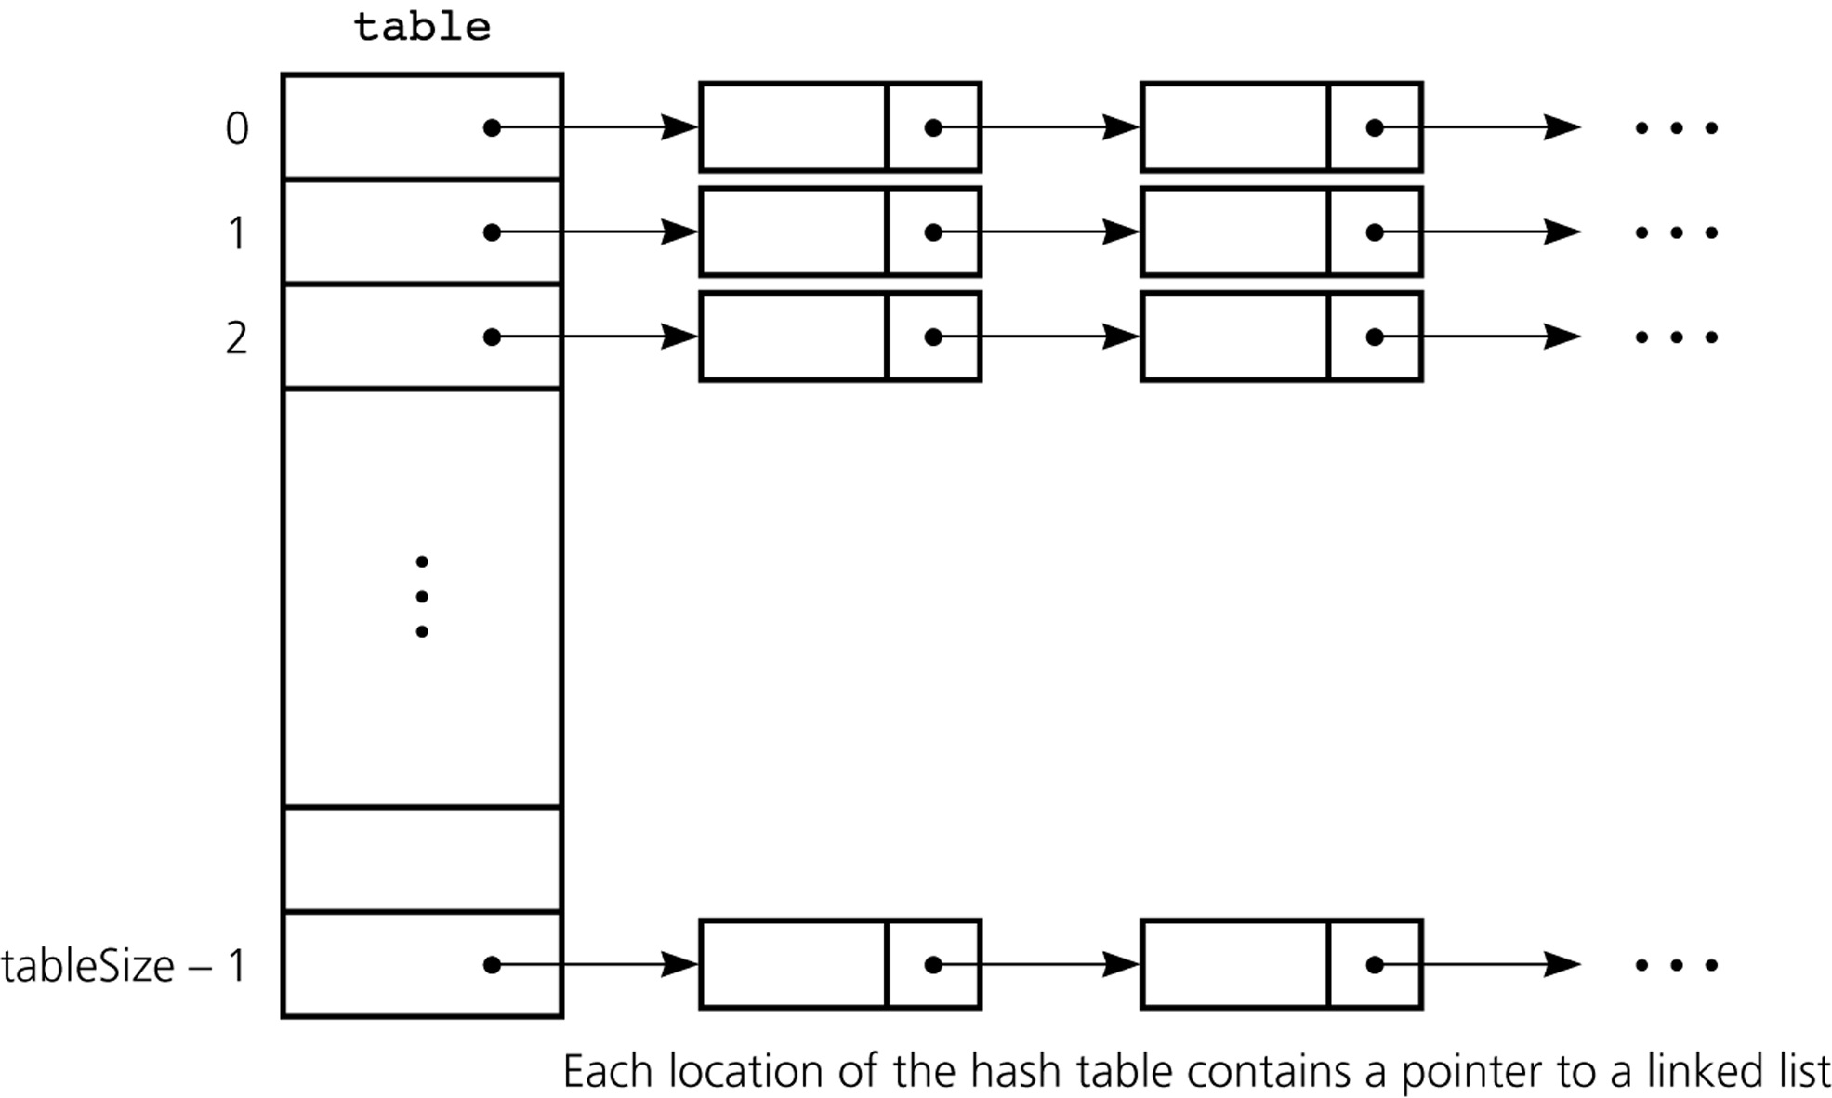
Figure: Separate chaining (using linked lists).
If array-based implementation of list is used: they are called buckets.
Notes:
Note: separate chaining has a similar behavior as secondary clustering, but the “clusters” will never interact with each other.

